Slide 1
Yeskenov Aldiyar
Wednesday, 15:00 – 16:00, 24B031763

Slide 2
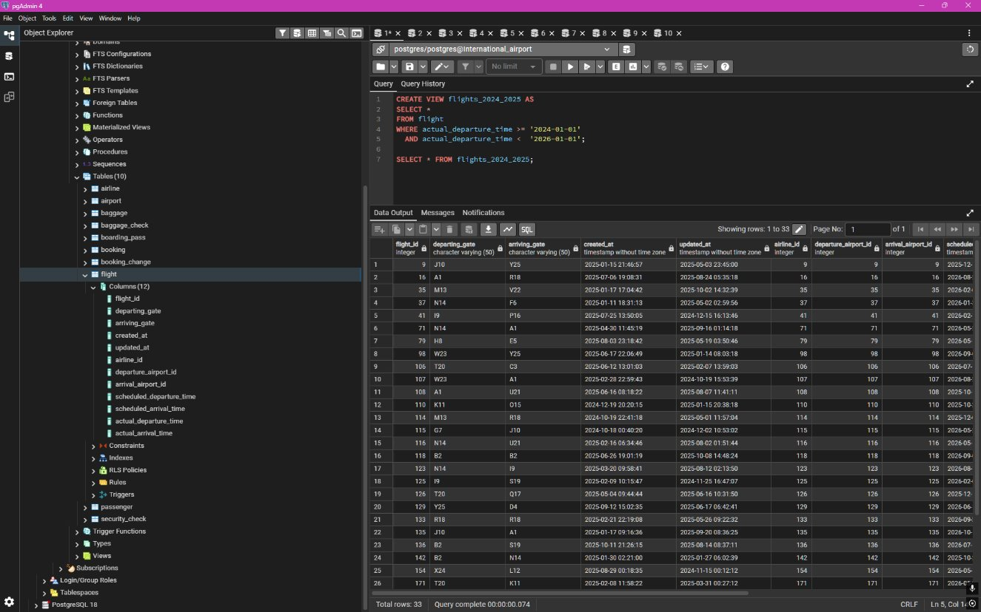
1. Create a view to show details of all flights that are departing on a specific date.

Slide 3
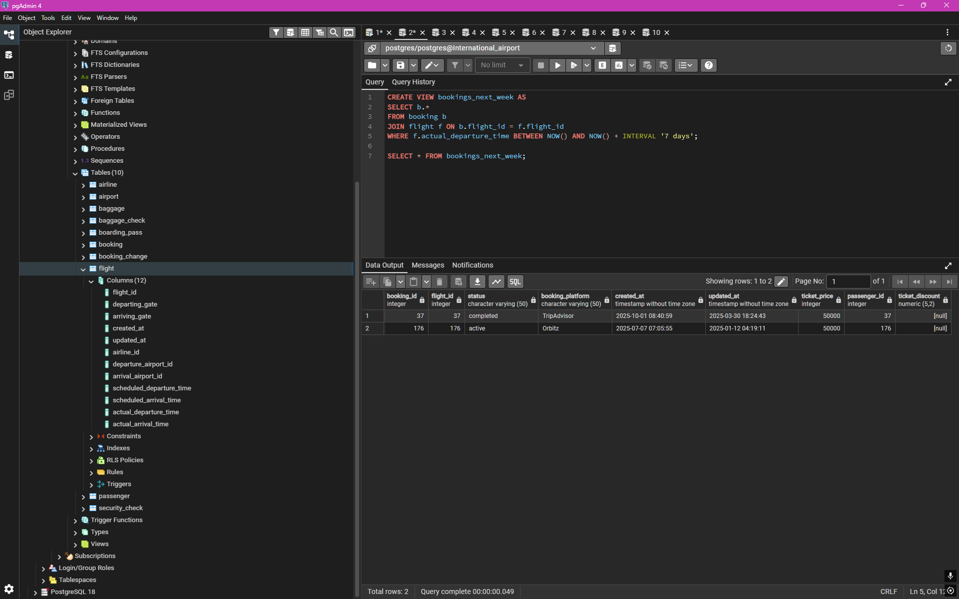
2. Create a view that shows bookings for flights scheduled to depart within the next week.

Slide 4
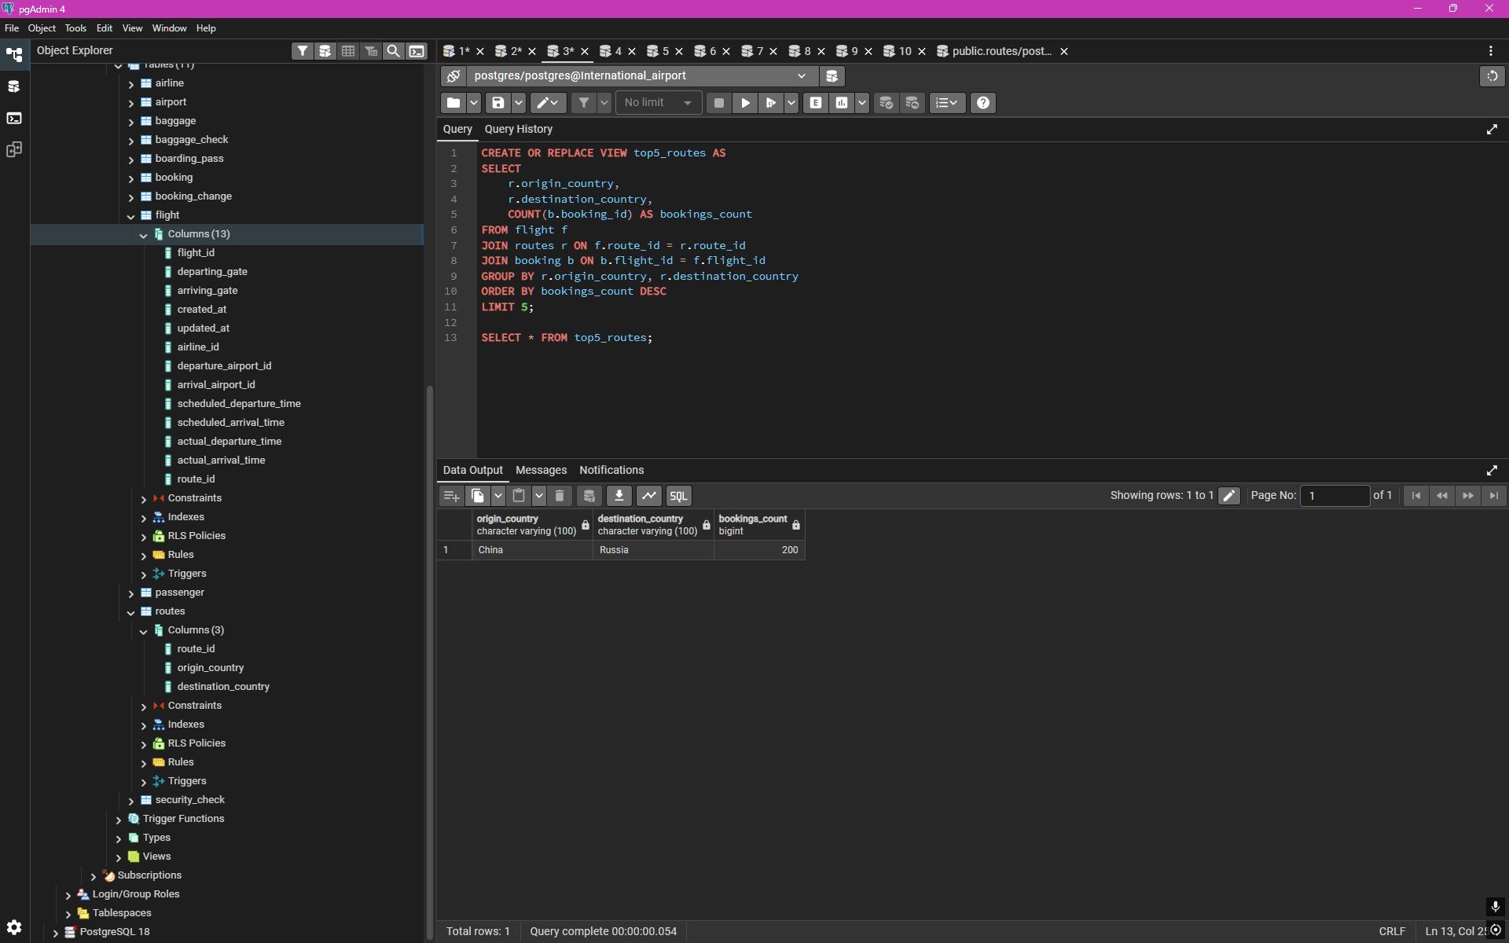
3. Create a view to show the top 5 most popular flight routes based on the number of bookings.

Slide 5
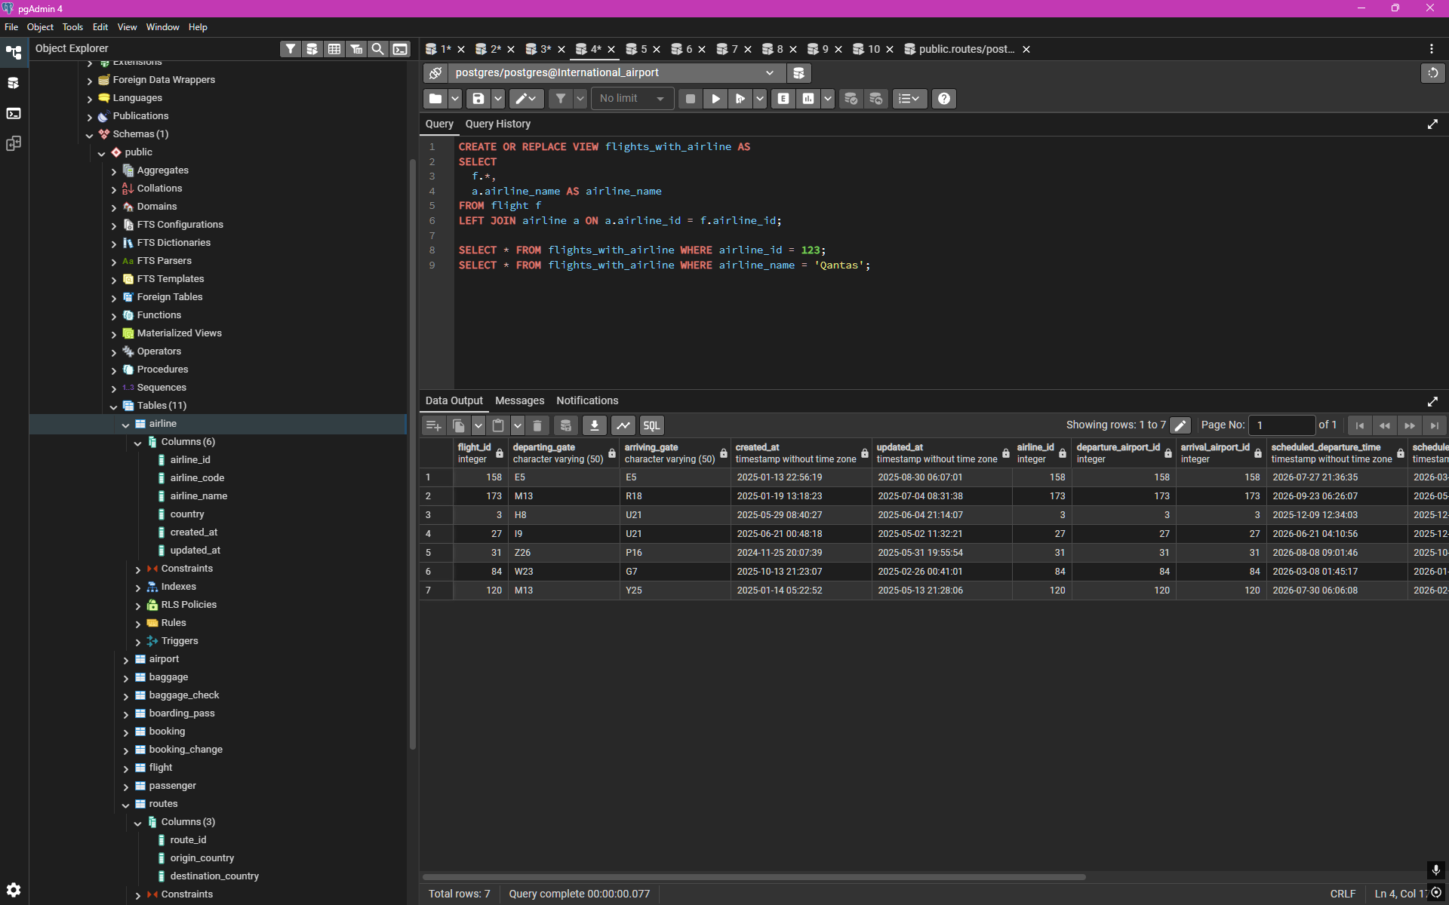
4. Create a view that lists all flights for a specific airline.

Slide 6
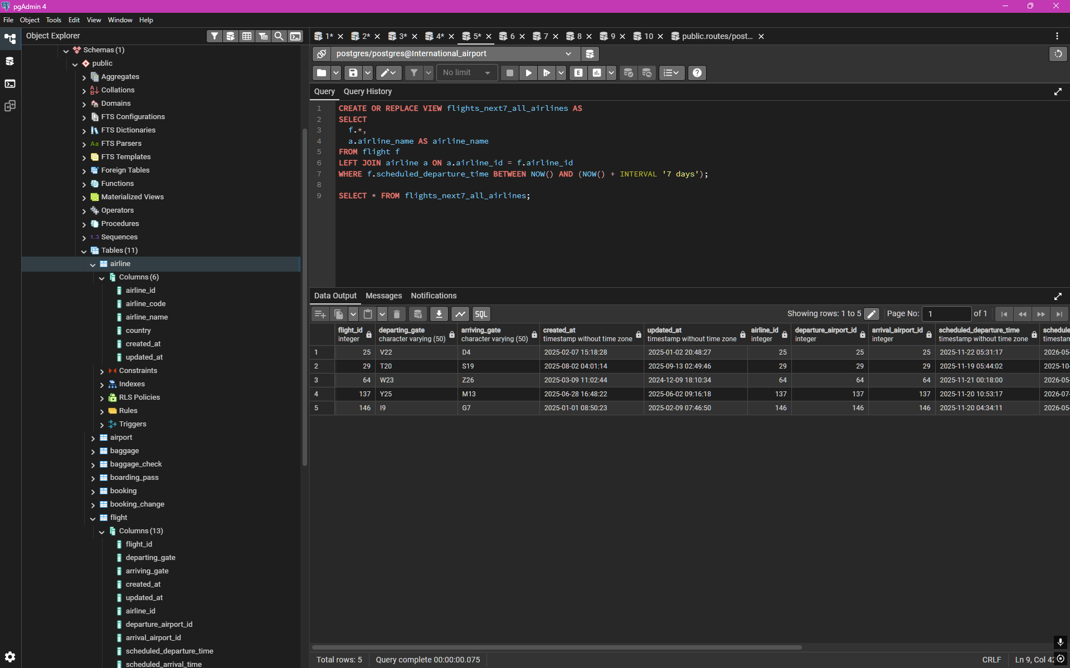
5. Modify the view created in task 4 to show only flights departing within the next 7 days for a specific airline.

Slide 7
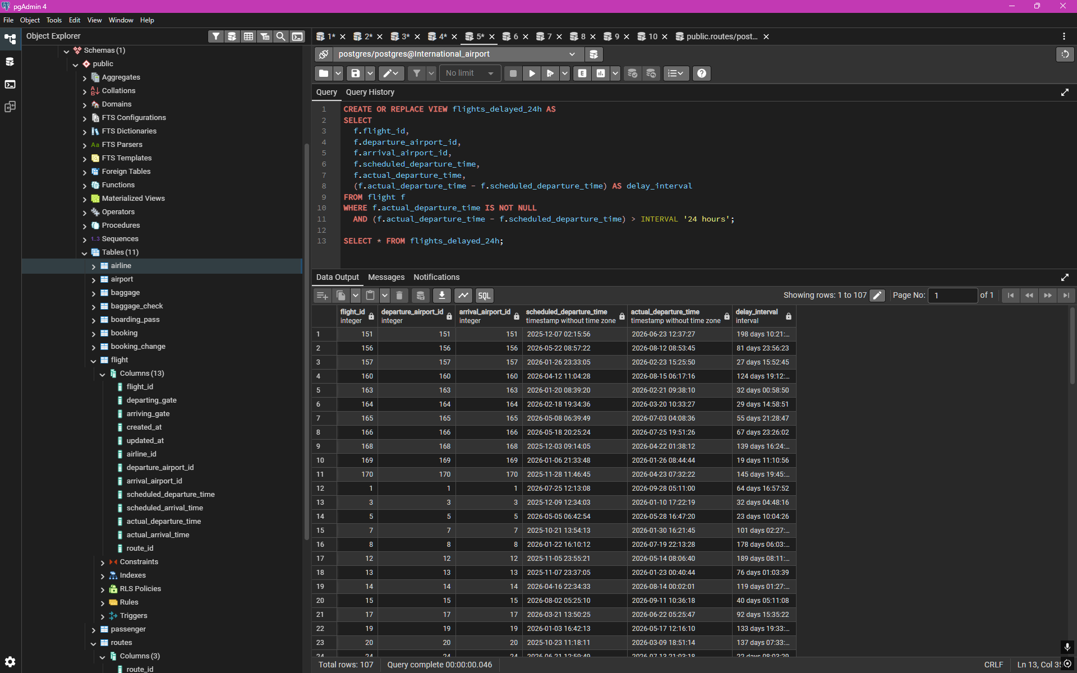
6. Create a view to show flights that are delayed by more than 24 hours.

Slide 8
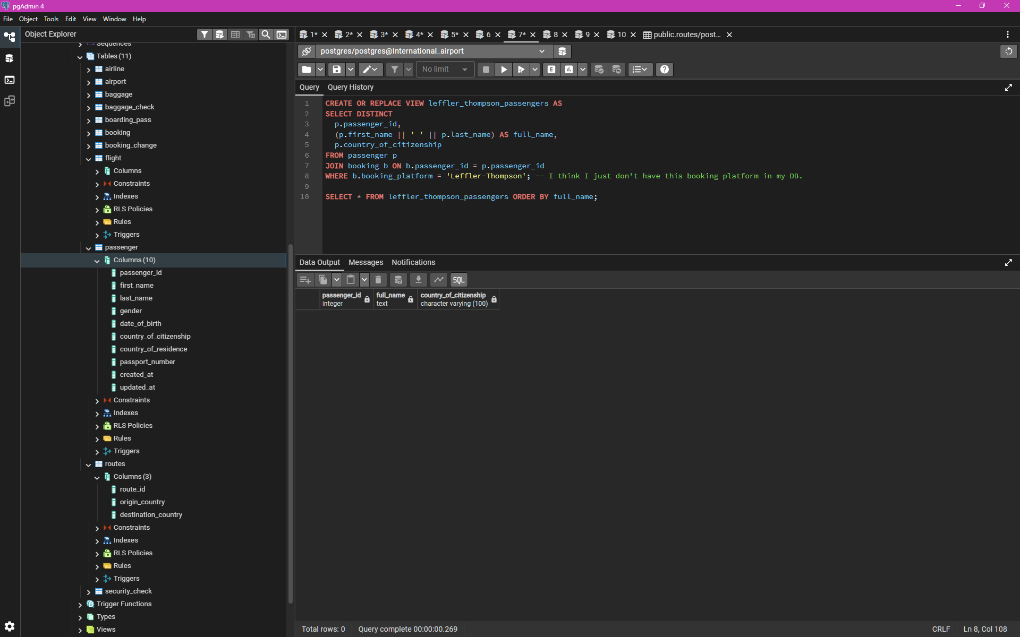
7. Create a view in which you can display the full name and country of origin of passengers who made bookings on Leffler-Thompson platform. Then show the list of that passengers.

Slide 9
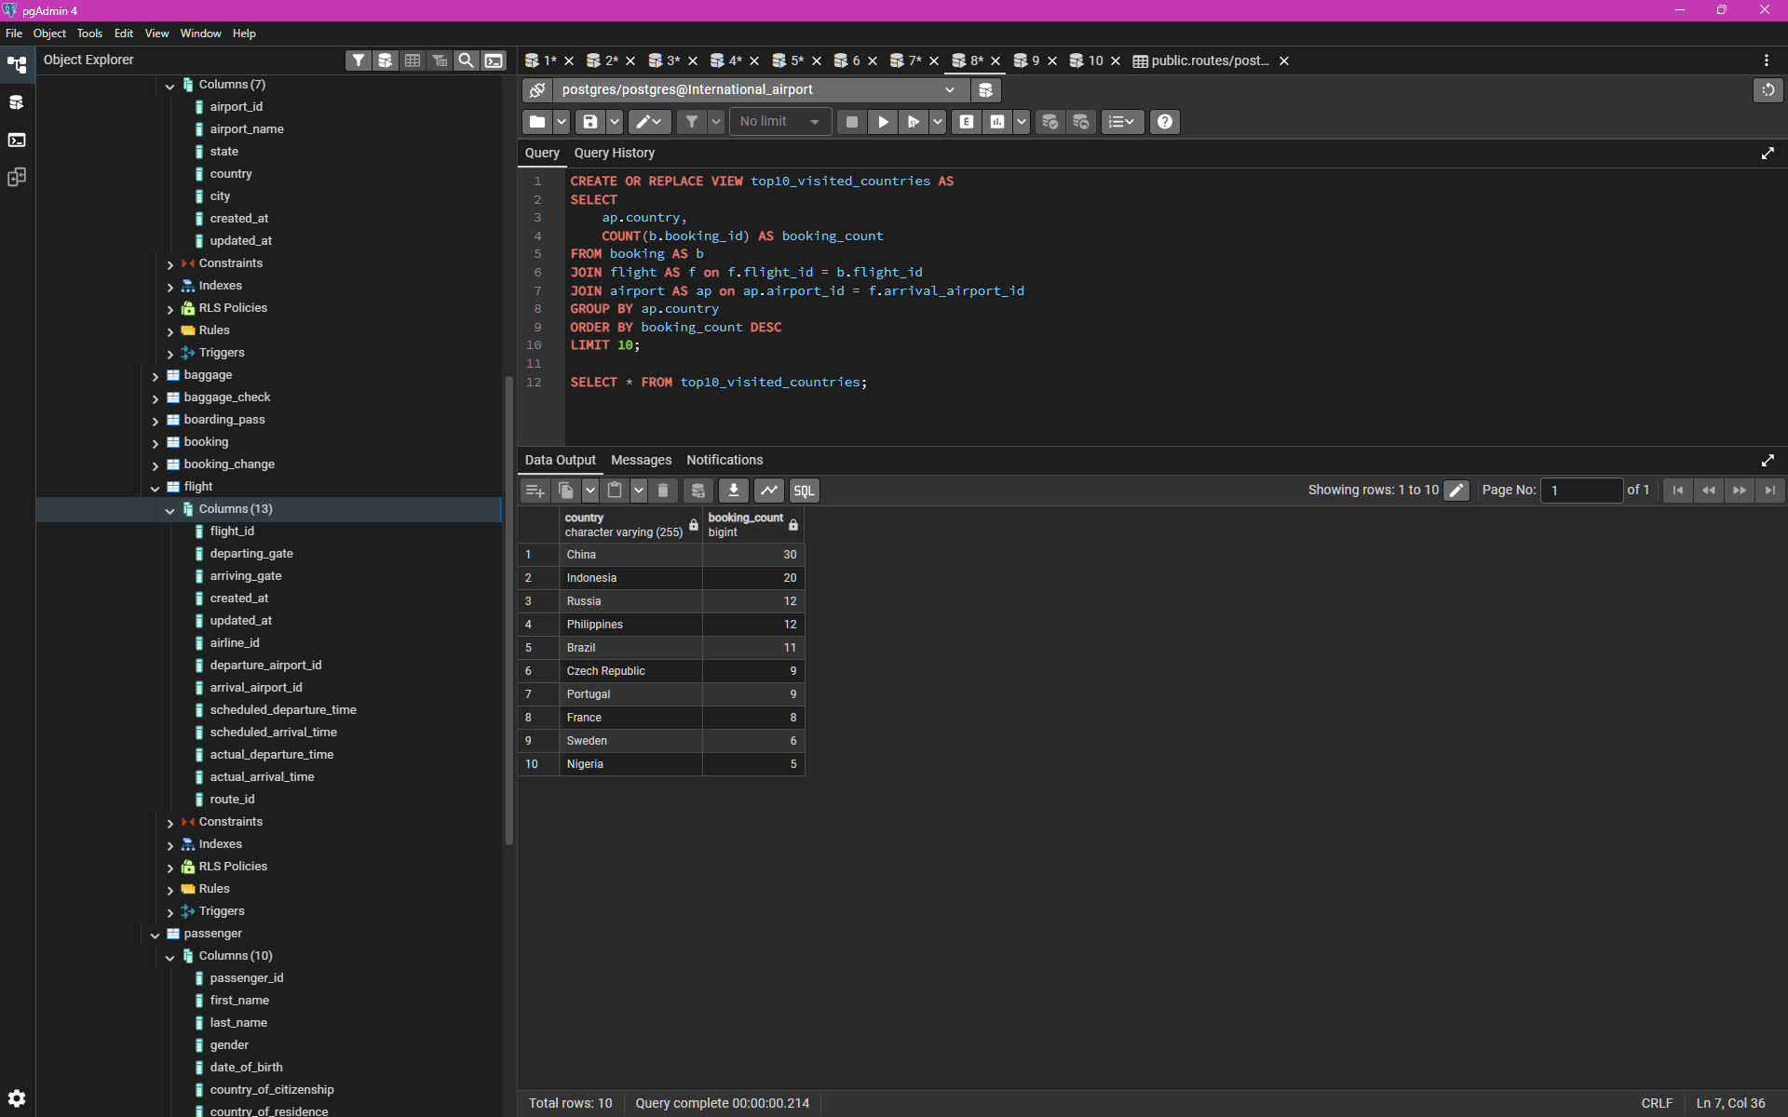
8. Create a view that shows top 10 most visited countries.

Slide 10
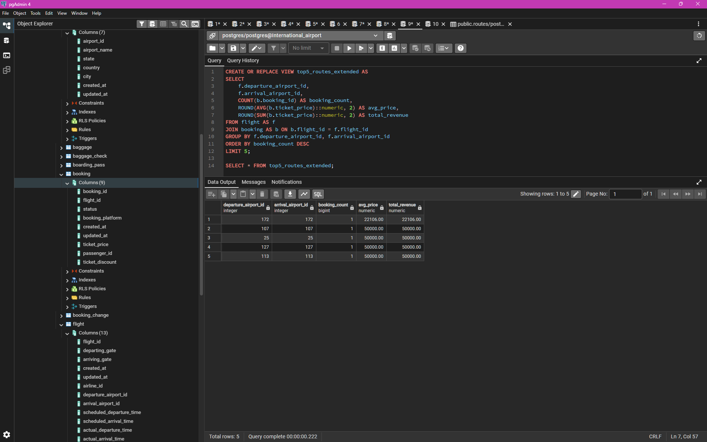
9. Update any of the created views by adding new information in the view table. Show results.

Slide 11
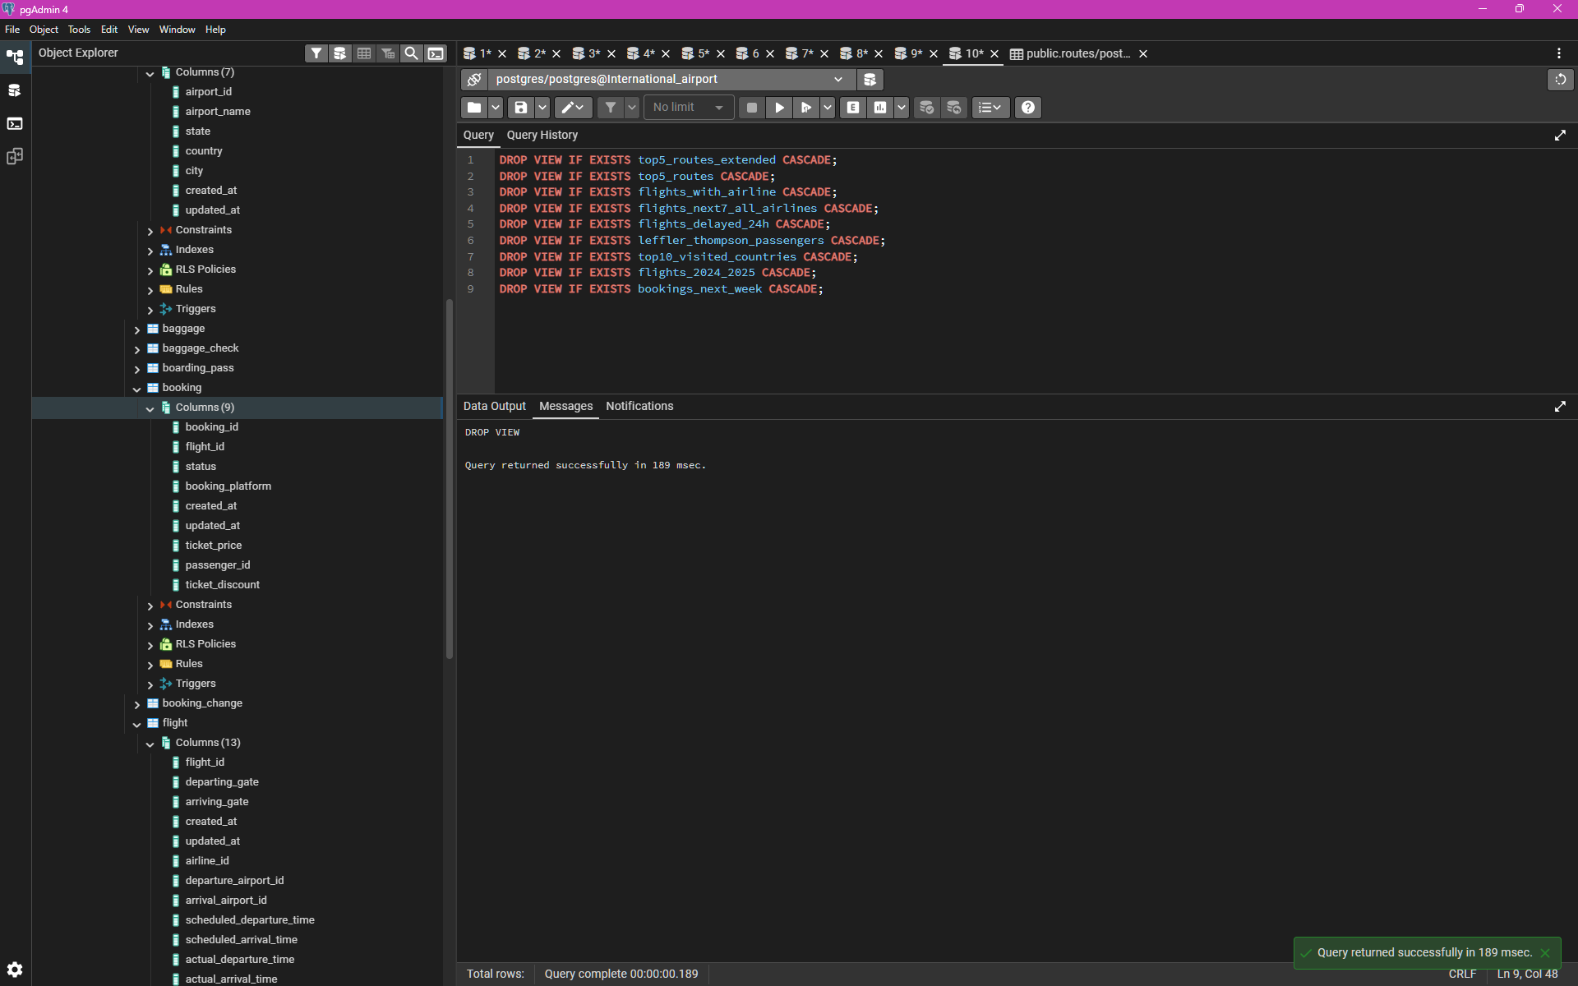
10. Drop all existing views

